Slide 1
Distributed System Architectures

Slide 2
A distributed system is a software system that interconnects a collection of heterogeneous independent computers, where coordination and communication between computers only happen through message passing, with the intention of working towards a common goal.
The idea behind distributed systems is to provide a viewpoint of being a single coherent system, to the outside world.
One of the major disadvantages of distributed systems is the complexity of the underlying hardware and software arrangements. This arrangement is generally known as a topology or an overlay. This is what provides the platform for distributed nodes to communicate and coordinate with each other as needed.

Slide 3
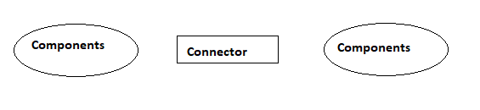
Distributed system architectures are bundled up with components and connectors.
Components can be individual nodes or important components in the architecture whereas Connectors are the ones that connect each of these components.
Component: A modular unit with well-defined interfaces; replaceable; reusable
Connector: A communication link between modules which mediates coordination or cooperation among components
So the idea behind distributed architectures is to have these components presented on different platforms, where components can communicate with each other over a communication network in order to achieve specifics objectives.

Slide 4
Architectural Styles
There are four different architectural styles when it comes to distributed systems.
The basic idea is to organize logically different components, and distribute those computers over the various machines.
Layered Architecture
Object Based Architecture
Data-centered Architecture
Event Based Architecture

Slide 5
1.Layered Architecture
The layered architecture separates layers of components from each other, giving it a much more modular approach.
A well known example for this is the OSI model that incorporates a layered architecture when interacting with each of the components.
Each interaction is sequential where a layer will contact the adjacent layer and this process continues.
But in certain cases, the implementation can be made so that some layers will be skipped, which is called cross-layer coordination.
Through cross-layer coordination, one can obtain better results due to performance increase.

Slide 6
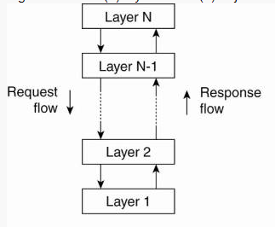
The layers on the bottom provide a service to the layers on the top.
The request flows from top to bottom, whereas the response is sent from bottom to top.
The advantage of using this approach is that, the calls always follow a predefined path, and that each layer can be easily replaced or modified without affecting the entire architecture.

Slide 7
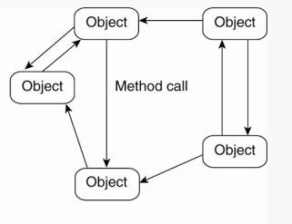
2. Object Based Architecture
This architecture style is based on loosely coupled arrangement of objects.
This has no specific architecture like layers.
Like in layers, this does not have a sequential set of steps that needs to be carried out for a given call.
Each of the components are referred to as objects, where each object can interact with other objects through a given connector or interface.

Slide 8
These are much more direct where all the different components can interact directly with other components through a direct method call.
communication between object happen as method invocations.
This has the following properties.
This architecture style is less structured.
component = object
connector = RPC or RMI

Slide 9
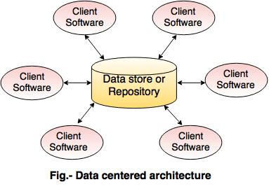
3. Data Centered Architecture
Processes communicate through a common repository
This is more like a producer consumer problem. The producers produce items to a common data store, and the consumers can request data from it. This common repository, could even be a simple database.
But the idea is that, the communication between objects happening through this shared common storage. This supports different components (or objects) by providing a persistent storage space for those components.

Slide 10
All the information related to the nodes in the system are stored in this persistent storage.
Some popular examples are distributed file systems, producer consumer, and web based data services.

Slide 11
4. Event Based Architecture
The entire communication in this kind of a system happens through events.
When an event is generated, it will be sent to the bus system.
With this, everyone else will be notified telling that such an event has occurred.
So, if anyone is interested, that node can pull the event from the bus and use it. Sometimes these events could be data, or even URLs to resources.
So the receiver can access whatever the information is given in the event and process accordingly. processes communicate through the propagation of events.
These events occasionally carry data. An advantage in this architectural style is that, components are loosely coupled. So it is easy to add, remove and modify components in the system.

Slide 12
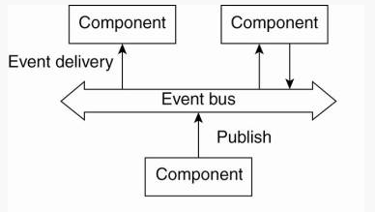
One major advantage is that, these heterogeneous components can contact the bus, through any communication protocol.
Between each node there is no direct communication or coordination. Instead, objects which are subscribed to the service communicate through the event bus.
The major advantages of this architecture is that the Components are - loosely coupled.

Slide 13
System Architectures
Centralized Architectures
Decentralized Architectures
1.Centralized Architectures
Basic Client–Server Model
Characteristics:
There are processes offering services (servers)
There are processes that use services (clients)
Clients and servers can be on different machines
Clients follow request/reply model with respect to using services

Slide 14
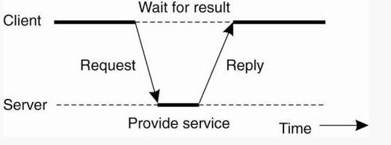
General interaction between a client and a server.
Both Connection-oriented service and Connection-less service are used for the connection establishment between two or more than two devices

Slide 15
Connection Oriented Services
There is a sequence of operation to be followed by the users of connection oriented service. These are:
Connection is established.
Information is sent.
Connection is released.
In connection oriented service we have to establish a connection before starting the communication. When connection is established, we send the message or the information and then we release the connection.
Connection oriented service is more reliable than connectionless service.
Example of connection oriented is TCP (Transmission Control Protocol) protocol

Slide 16
Connection Less Services
Each message is routed independently from source to destination.
The order of message sent can be different from the order received.
In connectionless the data is transferred in one direction from source to destination without checking that destination is still there or not or if it prepared to accept the message.
Authentication is not needed in this.
Example of Connectionless service is UDP (User Datagram Protocol) protocol.

Slide 17
Difference: Connection oriented and Connectionless service
In connection oriented service authentication is needed, while connectionless service does not need any authentication.
Connection oriented protocol makes a connection and checks whether message is received or not and sends again if an error occurs, while connectionless service protocol does not guarantees a message delivery.
Connection oriented service is more reliable than connectionless service.

Slide 18
2.Decentralized Architectures
In a centralized system, control is exerted by just one entity.
In a decentralized system, there is no single controlling entity. Instead, control is shared among several independent entities.
Vertical distribution
Horizontal distribution
Peer-to-peer architectures
Processes are all equal: the functions that need to be carried out are represented by every process ) each process will act as a client and a server at the same time

Slide 19
The P2P overlay network consists of all the participating peers as network nodes.
There are links between any two nodes that know each other
That is if a participating peer knows the location of another peer in the P2P network, then there is a directed edge from the former node to the latter in the overlay network.
Based on how the nodes in the overlay network are linked to each other, we can classify the P2P networks as unstructured or structured.

Slide 20
Structured P2P: nodes are organized following a specific distributed data structure
Unstructured P2P: nodes have randomly selected neighbors
Some well known structured P2P networks are Chord, CAN, and Tulip.
Gnutella, Gossip, and Kazaa are examples of unstructured P2P

Slide 21
Structured P2P Architecture
The meaning of the word structured is that the system already has a predefined structure that other nodes will follow.
Every structured network inherently suffers from poor scalability, due to the need for structure maintenance.
In general, the nodes in a structured overlay network are formed in a logical ring, with nodes being connected to the this ring. In this ring, certain nodes are responsible for certain services.
A common approach that can be used to tackle the coordination between nodes, is to use distributed hash tables (DHTs).
A traditional hash function converts a unique key into a hash value, that will represent an object in the network. The hash function value is used to insert an object in the hash table and to retrieve it.

Slide 22
Hash Function: Takes a key and produces a unique hash value
Mapping Function: Map the hash value to a specific node in the system
Lookup table: Return the network address of the node represented by the unique hash value.

Slide 23
Unstructured P2P Systems
There is no specific structure in these systems, hence the name "unstructured networks".
Due to this reason, the scalability of the unstructured p2p systems is very high.
These systems rely on randomized algorithms for constructing an overlay network.
As in structured p2p systems, there is no specific path for a certain node.
It's generally random, where every unstructured system tried to maintain a random path. Due to this reason, the search of a certain file or node is never guaranteed in unstructured systems.
The basic principle is that each node is required to randomly select another node, and contact it.
Let each peer maintain a partial view of the network, consisting of n other nodes
Each node P periodically selects a node Q from its partial view
P and Q exchange information and exchange members from their respective partial views

